Slide 1


RESTAURANT BOOKING WEB APPLICATION
B.TECH 2022-26 4TH SEM LEARNING PROJECT
BACHELOR OF TECHNOLOGY DEPARTMENT OF COMPUTER SCIENCE & ENGINEERING SCHOOL OF ENGINEERING AND TECHNOLOGY GANDHI INSTITUTE OF ENGINEERING & TECHNOLOGY UNIVERSITY, GUNUPUR- 765022, ODISHA March 2024

Slide 2
PROJECT PRESENTED BY :
ABINASH BHARAT JYOTI RATHA 22CSE080
RAJAT KUMAR DASH 22CSE139
SOUMYA RANJAN MOHAPATRA 22CSE215

Slide 3
TABLE OF CONTENT
INTRODUCTION
FEATURES
OBJECTIVE
HARDWARE AND SOFTWARE USED
FLOWCHART
ER – DIAGRAM
INTERFACE
CONCLUSION

Slide 4
INTRODUCTION
In this project, we present an innovative solution that brings convenience and efficiency to the dining experience - our Restaurant Booking Web Application. In a world where time is of the essence and digital solutions continue to redefine our daily interactions, this application serves as a bridge between food enthusiasts and their favorite dining establishments. Traditional methods of making restaurant reservations are often time-consuming and lack the seamless experience we've come to expect in the digital age. Recognizing this gap, we set out to create a solution that not only simplifies the reservation process but enhances the overall dining journey.

Slide 5
FEATURES
User Registration and Login : Streamlined registration process with essential details. User-friendly login mechanism for returning customers.
Table Reservation : Intuitive calendar for easy date selection. Time slot availability for efficient booking. Real-time synchronization with restaurant databases for accurate reservation status.
Admin Panel : We have admin panel to efficiently manage reservations, monitor user activity, and maintain control over the platform's content and functionality.

Slide 6
OBJECTIVE
Enhance User Experience : Provide a user-friendly and intuitive platform that simplifies the restaurant reservation process
Promote Business Growth : Support the growth of participating restaurants by increasing their online visibility and attracting a wider customer base
Demonstrate Technological Proficiency : Showcase proficiency in utilizing modern web development technologies, including HTML, CSS ,Bootstrap, JavaScript, and Node.js.

Slide 7
HARDWARE AND SOFTWARE USED
Hardware Used : LAPTOP
Language Used : 1)HTML
2)CSS
3)JAVASCRIPT
4)BOOTSTRAP
5)NODE.JS
6)MONGO DB
Software Used : 1) VS CODE
2)WEB BROWSER

Slide 8
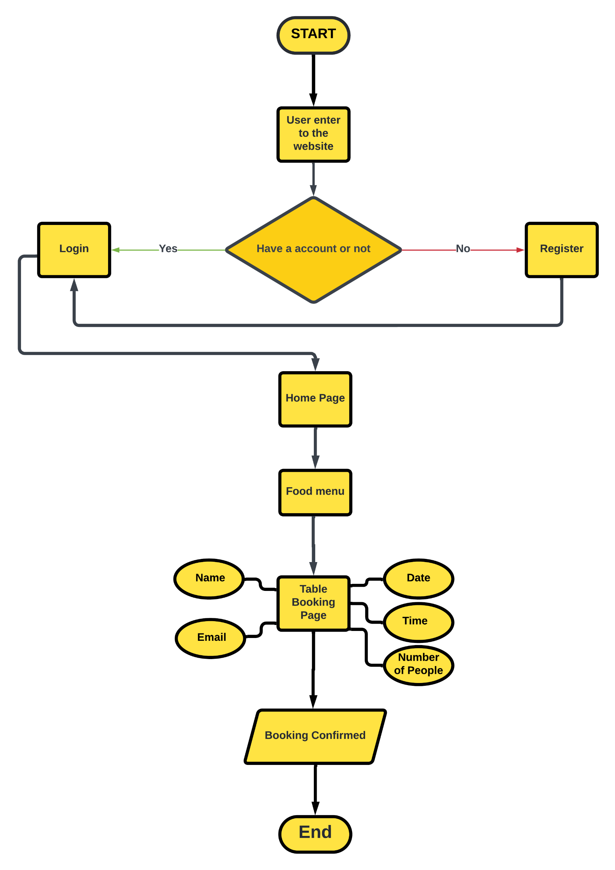
FLOWCHART

Slide 9
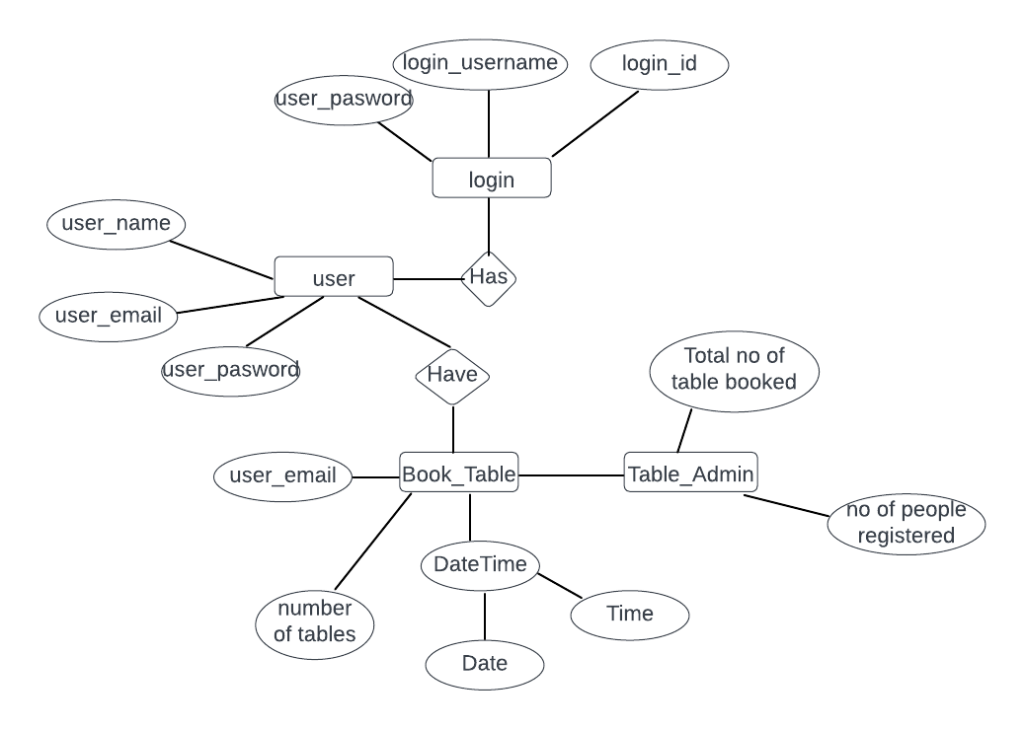
ER – DIAGARM

Slide 10
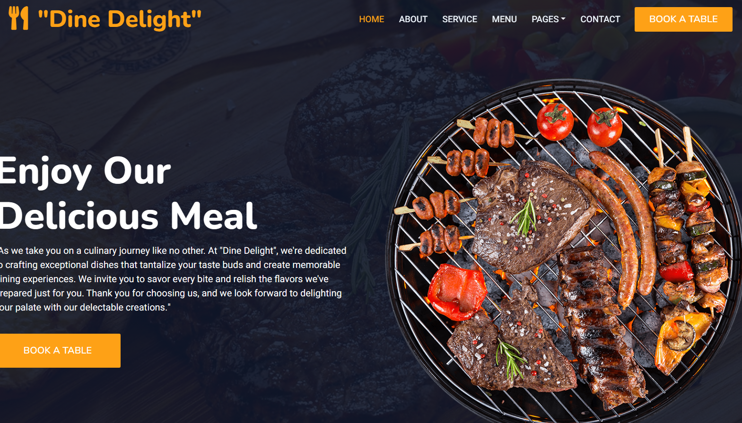
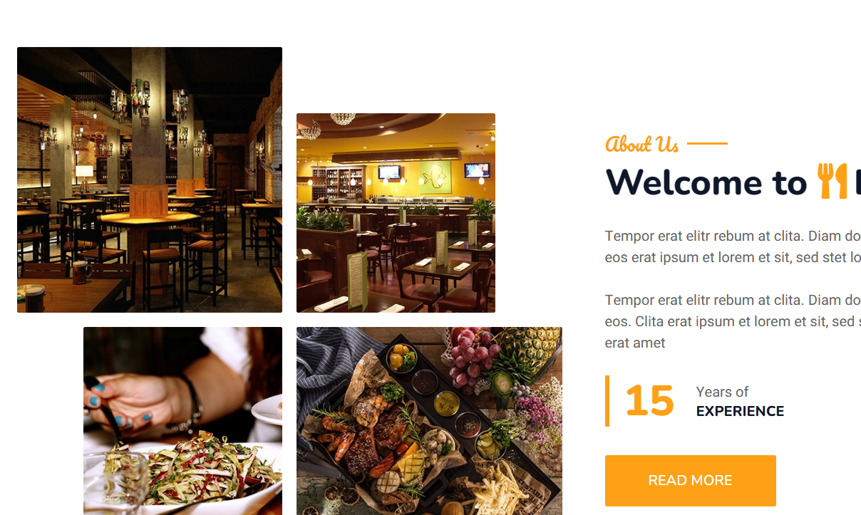
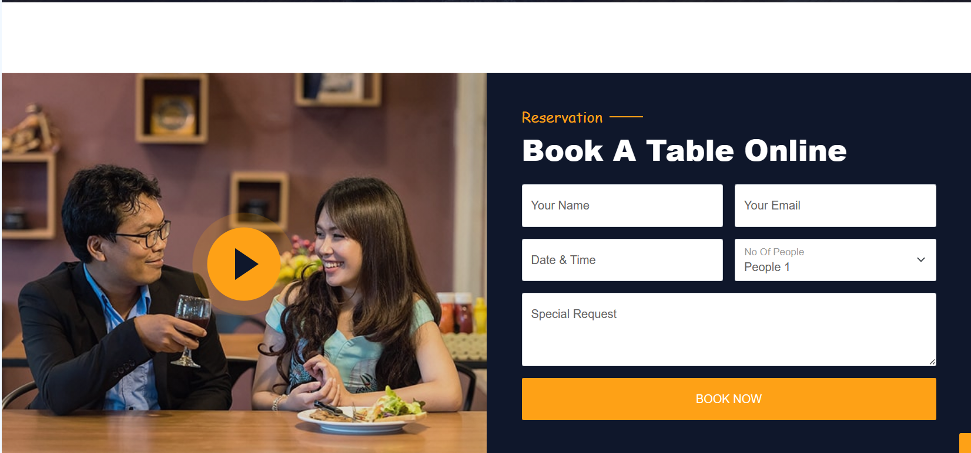
INTERFACE

Slide 11
CONCLUSION
In summary, our restaurant website makes it easy for you to see what we offer, reserve a table, and become part of our online community. We want to give you a great experience, whether you're a new guest or a loyal customer. So take a look around our website, book your next meal with us, and join our online community. Thanks for listening, and we can't wait to see you soon!

Slide 12
THANK YOU
ABINASH BHARAT JYOTI RATHA 22CSE080
RAJAT KUMAR DASH 22CSE139
SOUMYA RANJAN MOHAPATRA 22CSE215

